Slide 1
Unsupervised learning for auditory data
Lectuer: Ofir Lindenbaum
Presnter: Mordehay Moradi

Slide 2
Motivation
The paper: “Unsupervised Scalable Representation Learning for Multivariate Time Series”
Learning general-purpose representations for multivariate time series
Real-life time series are rarely or sparsely labeled
Recurrent networks are not scalable nor suited to long time series

Slide 3

Problem
Identify recordings by the speaker’s gender without any label

Slide 4
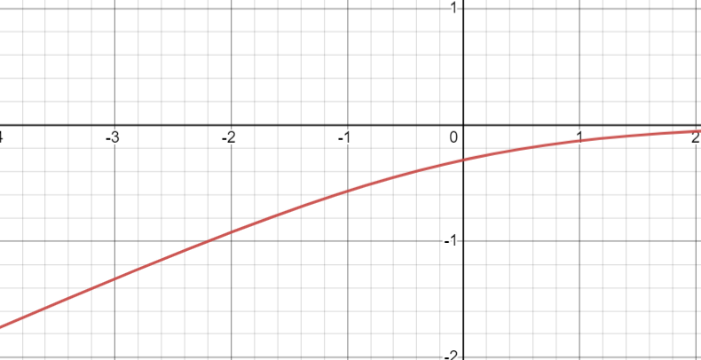
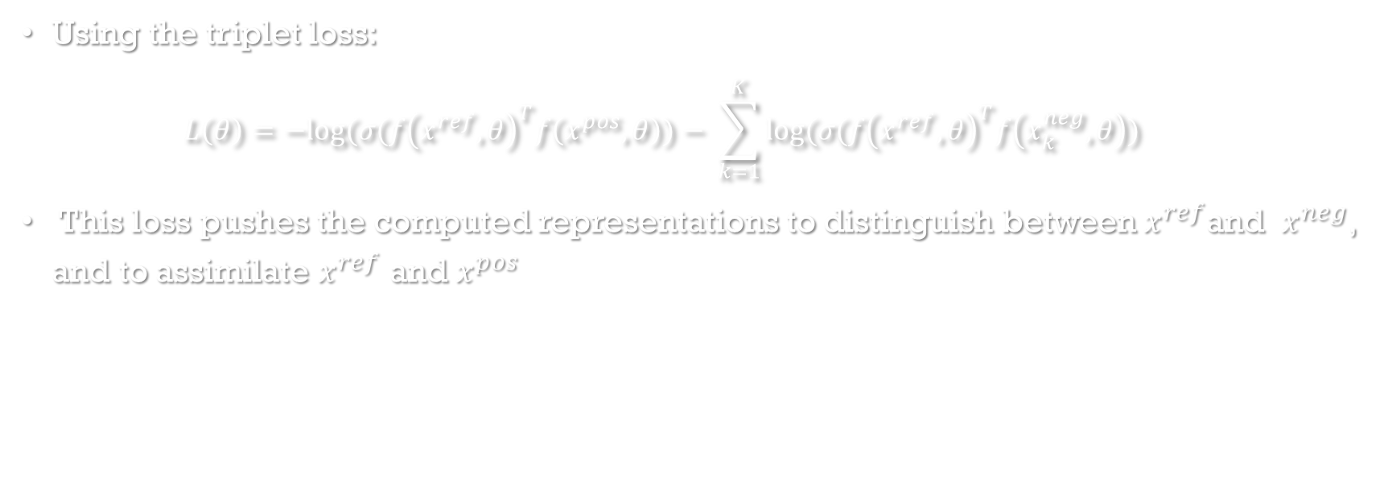

workaround
Using the triplet loss:
$$L\left(θ\right)=−log⁡(σ({f\left(x^{ref}, θ\right)}^{T}f\left(x^{pos}, θ\right))− \sum_{k=1}^{K}{log⁡(σ({f\left(x^{ref}, θ\right)}^{T}f\left(x_{k}^{neg}, θ\right))}$$
This loss pushes the computed representations to distinguish between $x^{ref}$and $x^{neg}$, and to assimilate $x^{ref}$ and $x^{pos}$
$log⁡(σ$(x))

Slide 5
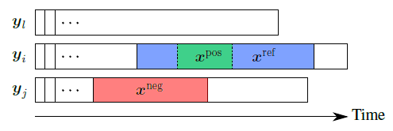
Cont - Recordings selection
For training the model one must choose the positive and negative samples in a clever way

Slide 6
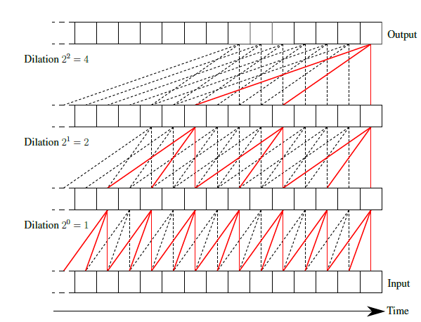
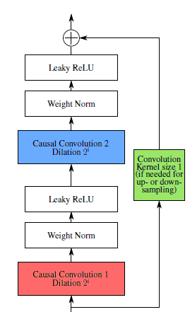
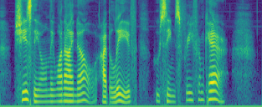
Cont
Using Encoder Architecture as follows:

Slide 7
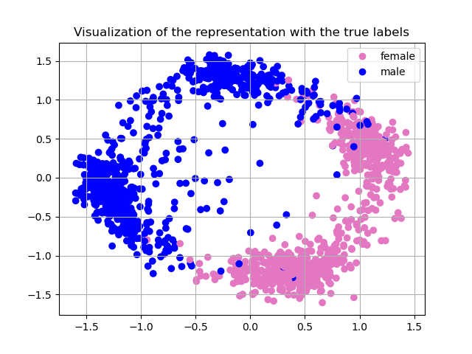
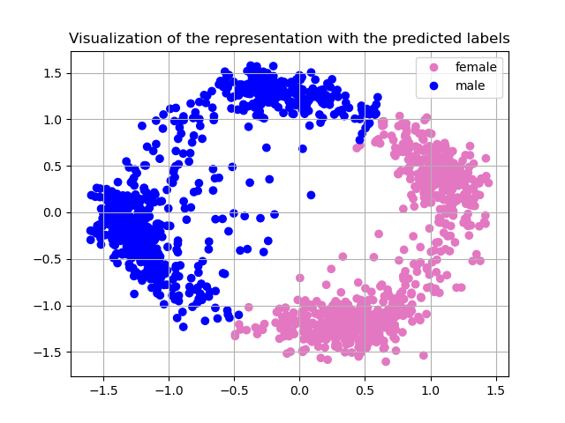
Results

Slide 8
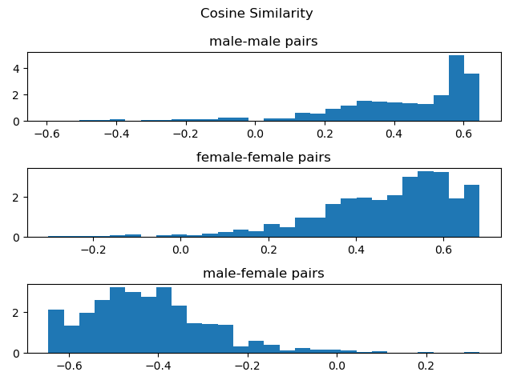
Cont – Cosine Similarity Metric

Slide 9
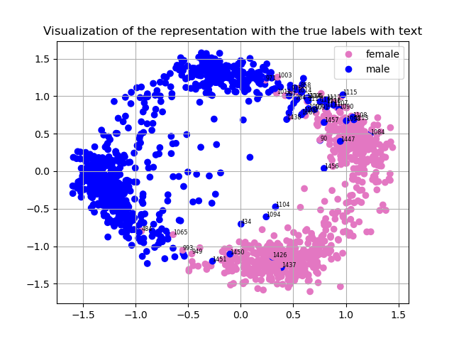
Cont – Wrong assigment
Several reasons to wrong clustering:
Distorting of the voice
Wrong negative sample
Reducing to small dimension (2d)

